Slide 1
AUD-FAEC: Training Subcommittee’s
Brief on the
Audit Training Needs Assessment
“Survey Results and Recommendations”
Andrew Smith – CIGIE Fellow / L&MS Academy

Slide 2
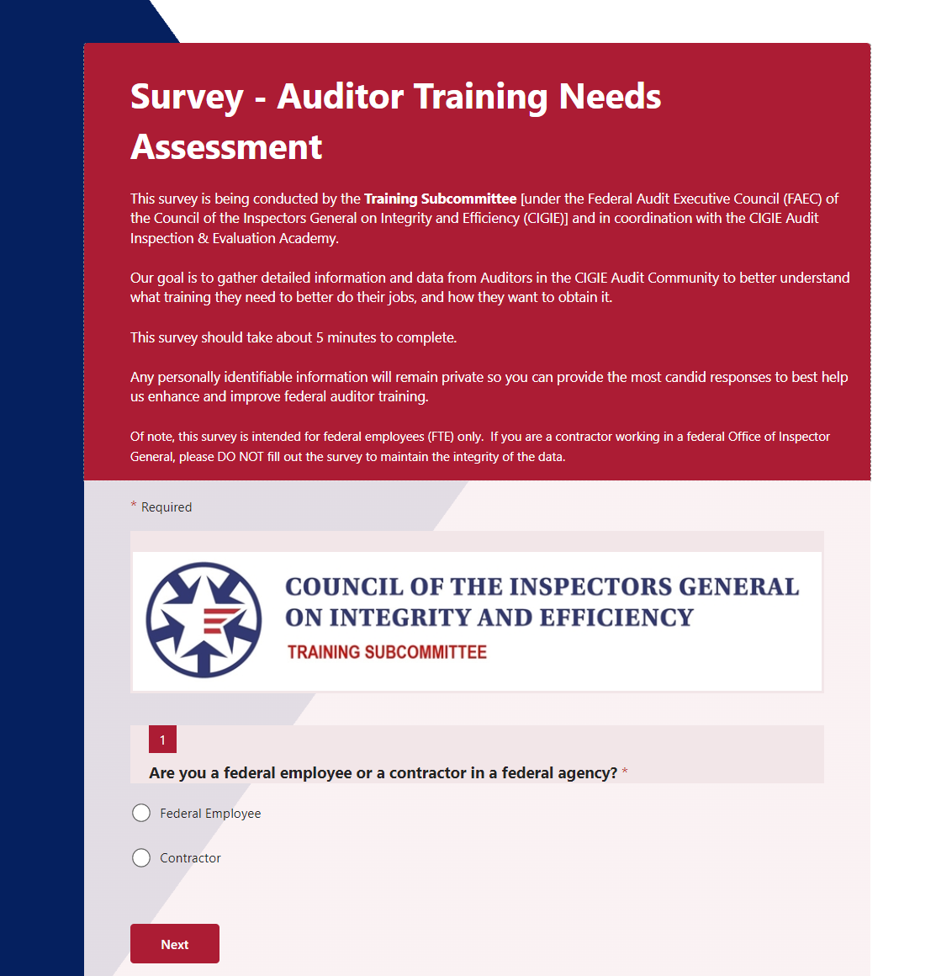
Survey Purpose
Our goal is to gather detailed information and data from Auditors in the CIGIE Audit Community to better understand what training they need to better do their jobs, and how they want to obtain it.
Notes:
Our goal is to gather detailed information and data from Auditors in the CIGIE Audit Community to better understand
what training they need to better do their jobs, and
how they want to obtain it.
---
Used the online app MS Forms to send out a link and gather responses into a single Excel document for analysis.

Slide 3
Question Breakdown
1 thru 7: Demographics
8 thru 13: Funding, Training providers, preferred delivery, and Use of YB
14 thru 33: Technical Skills Needed
34 thru 45: Management Skills Needed
45: If Introductory class offered…
46: If Intermediate class offered…
47: Comments
Notes:
1 thru 7: Demographics (8)
8 thru 13: Funding, Training providers, preferred delivery, and Yellow Book (6)
14 thru 33: Technical Skills Needed (20)
34 thru 45: Management Skills Needed (12)
45: If Introductory class offered… (1)
46: If Intermediate class offered… (1)
47: Comments (1)

Slide 4
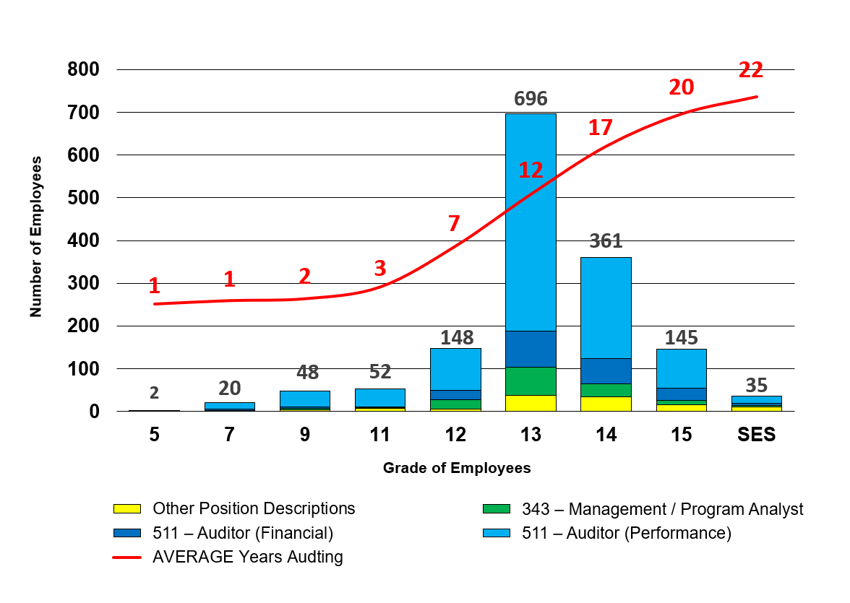
Demographics
1,508 (25% of 6K) of all auditors responded
64 OIGs (86% of 74) Listed
For 10 OIGs NOT responding = about 300 auditors (5% of 6K) that did not receive the survey
Exceptional representation across IG Community!
Notes:
1 thru 7: Demographics
Approx Percent of Respondents
5-13 = 65%
= 25%
15+ = 10%
COUNT of GS Position Descriptions Totals
511 – Auditor (Financial) 212
511 – Auditor (Performance) 1,045
343 – Management / Program Analyst 137
"Other" Position Descriptions 114
-----
8 thru 13: Funding, Training providers, preferred delivery, and Yellow Book
14 thru 33: Technical Skills Needed
34 thru 45: Management Skills Needed
45: If Introductory class offered…
46: If Intermediate class offered…
47: Comments

Slide 5
Certifications
1,508 respondents
Of 657 with any,
over 90 different certifications listed in the “others” category, including:
CFE, CGFM, CICA, CFF, CGAP, etc.
Notes:
CERTIFICATIONS
AMP
Association of Inspectors General
CCSA
CDFM
CDFM-A
CECFE
CEH
Certification in Risk Management Assurance (CRMA)
Certified Financial Manager
Certified Government Auditing Professional
Certified Information Systems Security Professional (CISSP)
Certified Inspector General Auditor (CIGA)
Certified Tester Foundation Level (CTFL)
CFE
CFS
CGAP
CGFM
CGMA
CISM
CISSP CFSA
CLEA
CMA
COR
Cost Accounting
CRISC
DAWIA 3 in Engineering
DAWIA Certified Acquisitions Professional – Level II DoD Financial Management Certification – Level II
Defense Acquisition Corps
DoD FM Level 2
GFFM
Grant specialist
ITGC
SSCP
CDFM
Certification in Risk Management Assurance (CRMA)
Certified Accounting Information Security (CAIS)
Certified Defense Financial Manager
Certified Enterprise Risk Management Professional
Certified Ethical Hacker
Certified Financial Services Audit Certificate
Certified Fraud Analyst
certified fraud auditor
Certified Fraud Examiner
Certified Fraud Examiner Grants Management
Certified Government Auditing Professional (CGAP)
Certified Government Financial Manager
Certified Government Financial Manager (CGFM)
Certified Government Financial Manager (CGFM)
Certified Information Security Manager (CISM)
Certified Information Systems Auditor
Certified Inspector General
Certified Inspector General Auditor (CIGA)
Certified Internal Auditor (CIA)
Certified Internal Controls Auditor (CICA)
Certified Knowledge Manager
Certified Management Accountant
Certified Public Accountant (CPA)
Certified Vulnerability Assessor
CFA
CFE
CFF
CGAP
CGFM
Chartered Financial Analyst
CICA
CIGA
CISA
CISM
CISSP
CMA
CompTIA Security+
COR
CPE
CRMA
DAWIA
DOD Acquisition Certification Level 2
DoD Financial Management Certification – Level 3
DoD Financial Mgmt
Engineer in Training (EIT)
FAC-C 2
FAC-C II
FAC-C Level 1
FAC-COR
FITSI
FM Cert
GrTotal
Internal Acquisition Auditor
IT certs
Licensed Attorney
Masters Certificate in Govenment Contracting
MBA
MSA
Non Profit Management (Public Administration)
None held
PMP
Project Management Professional (PMP)
-----
8 thru 13: Funding, Training providers, preferred delivery, and Yellow Book
14 thru 33: Technical Skills Needed
34 thru 45: Management Skills Needed
45: If Introductory class offered…
46: If Intermediate class offered…
47: Comments

Slide 6
Funding / Availability
Notes:
1 thru 7: Demographics
8 thru 13: Funding, Training providers, preferred delivery, and Yellow Book
14 thru 33: Technical Skills Needed
34 thru 45: Management Skills Needed
45: If Introductory class offered…
46: If Intermediate class offered…
47: Comments

Slide 7
Preferred Training Delivery Methods
Notes:
1 thru 7: Demographics
8 thru 13: Funding, Training providers, preferred delivery, and Yellow Book
14 thru 33: Technical Skills Needed
34 thru 45: Management Skills Needed
45: If Introductory class offered…
46: If Intermediate class offered…
47: Comments

Slide 8
“TOP FIVE” Audit TECHNICAL Skills Needed…
Notes:
14 thru 33: Technical Skills Needed to CONDUCT the audit work:
20 total TECHNICAL questions – TOP FIVE:
1. Developing findings - (i.e., Developing elements of a finding; Reassessing internal controls)
2. Reporting results - (i.e., Developing an audit message; Drafting a report; Preparing and conducting an exit conference; Finalizing and issuing an audit report)
3. Analyzing and visualizing data - (e.g., Using Advanced Excel, Tableau, PowerBI, Python; Using best practices for data visualization)
4. Identifying applicable internal controls
5. Developing an audit methodology
-----
6 Analyzing information (i.e., Analyzing collected information; Documenting analyses)
7 Developing audit objectives and scope
8 Developing an audit timeline and schedule
9 Finalizing an audit plan
10 Conducting surveys (e.g., Writing survey questions, Using various survey tools)
11 Identifying audit criteria
12 Indexing and referencing a report
13 Requesting and reviewing data and documents
14 Using audit documentation software (e.g., TeamMate, eCase)
15 Planning, conducting, and documenting interviews
16 Conducting audit background research
17 Communicating throughout the audit (i.e., Responding to information requests; Reporting potential fraud, other illegal acts, or abuse; Coordinating with internal and external stakeholders)
18 Conducting and documenting site visits
19 Using MS Office products (e.g., Word, Excel)
20 Planning and conducting an entrance conference
-----
QUESTION WAS PHRASED AS:
“Based on your current position in your OIG - Please rate auditor training NEEDS in each of the following auditing skills - If you are an auditor on an audit team, or an Auditor-In-Charge / Team Lead, think about what training YOU NEED to do your work. If you are an Audit Manager / Director, think about what training you feel YOUR audit teams NEED to do their work. If you are a Senior Executive, think about what training YOUR Audit Managers, Directors, and audit team leads and team members NEED to do their work:”
-----
34 thru 45: Management Skills Needed
45: If Introductory class offered…
46: If Intermediate class offered…
47: Comments

Slide 9
“TOP FIVE” Audit MANAGEMENT Skills Needed…
Notes:
34 thru 45: Management Skills Needed to LEAD and MANAGE the audit work:
12 total MANAGEMENT questions – TOP FIVE:
1. Managing the audit - (from audit proposal / objective development to recommendation follow up)
2. Reviewing the work of others
3. Identifying & managing resource requirements
4. Producing non-traditional work products (e.g., flash reports, management alerts / advisories, etc.)
5. Adjusting audit plan as needed
-----
6. Monitoring timeline and schedules
7. Conducting quality assurance and improvement activities
8. Following up on audit recommendations
9. Conducting a peer review
10. Writing audit policies
11. Identifying & mitigating impairments to independence
12. Monitoring the work of an independent public accounting firm
-----
QUESTION WAS PHRASED AS:
“Based on your current position in your OIG -
Please rate auditor training NEEDS in each of the following auditing skills –
If you are an auditor on an audit team, or an Auditor-In-Charge / Team Lead, think about what training YOU NEED to do your work.
If you are an Audit Manager / Director, think about what training you feel YOUR audit teams NEED to do their work.
If you are a Senior Executive, think about what training YOUR Audit Managers, Directors, and audit team leads and team members NEED to do their work:”
-----
45: If Introductory class offered…
46: If Intermediate class offered…
47: Comments

Slide 10
If INTRODUCTION to Performance Auditing course offered…
How likely would you be to send your inexperienced new / junior staff?
Notes:
45: If Introductory class offered…
QUESTION WAS PHRASED AS:
FOR Team Leads and above:
If CIGIE resumed offering an “INTRODUCTION to Performance Auditing” course, that provided high-level initial training on Yellow Book requirements and audit processes for new / junior auditors in the IG community, and that ran for a full week (awarding 36-40 CPEs), with both in-person and virtual versions:
How likely would you be to send your inexperienced new / junior staff?
N/A – Never – Likely -- Definitely
46: If Intermediate class offered…
47: Comments

Slide 11
If INTERMEDIATE Performance Auditing course offered…
How likely would you be to send your experienced junior / intermediate staff?
Notes:
46: If Intermediate class offered…
QUESTION WAS PHRASED AS:
FOR Audit Managers / Directors and above:
If CIGIE resumed offering an “INTERMEDIATE Performance Auditing” course, that provided more detailed training on specific auditor skills and audit processes for auditors with several years’ experience in the IG community and multiple performance audits completed, and that ran for a full week (awarding 36-40 CPEs), with both in-person and virtual versions:
How likely would you be to send your experienced junior / intermediate staff?
N/A – Never – Likely -- Definitely
-----
47: Comments

Slide 12
(Some) Comments in the Survey
“We need more training internally led by our own best auditors.”
“If online training is available, it would be better to be ON DEMAND and not at a particular time as our office is 12 hours ahead of DC time, so all online training is usually during our nights.”
“I attended intro to performance auditing in person in DC offered by CIGIE and it was a great experience, would love to do for intermediate performance auditing too.”
“We truly need indexing and referencing training.”
“Training locations outside of DC.”
“The trainings listed in this questionnaire should be made required trainings.”
“REQUIRED Leadership Training for GS14s, GS 15s, and SES. As staff gets promoted, managers seem to be more technical and forget about being a leader, mentor and a coach.”
“We would like classes on data analysis and how to perform analysis.”
“CIGIE always provides great training.”
“Very good, different survey. nothing to add.”
“I don't know.”
“Greater training in identifying and testing internal controls according to newer yellowbook guidance/requirements. Greater training on data analytics.”
“Tired of taking random surveys with no real action.”
Notes:
47: Comments
366 real comments –
125 more “N/A” or “No Comment” etc.
“I attended CIGIE's introduction to performance auditing when I first began. I had no previous experience and found it wonderful training. I returned for the intermediate course a few years after and both have been the best training auditor training I've done since joining this line of work.”
“My organization does not emphasize training that satisfies CPA/CMA/CIA ongoing education requirements. Please ensure all training can count towards continuing accreditation.”
“Please provide OIG specific training. General audit training does not fully prepare a new auditor for the IG environment.”
““Many of the trainings provided are panel based discussions that provide helpful tips and case studies. Is it possible to provide hands on training where we are able to actively use what was taught during the training itself? It can be a multi training experience where we have a discussion and break out room on how to implement it during the first session and a week or so later have a second session to discuss what we have and receive feedback from our peers.”
“Classes are often separated by number of experience or GS level but there are a number of staff who are tenured in the agency but don't necessarily know the yellow book and performance auditing so when they see a course such as "Intro to Perf Auditing" they will be less inclined to attend. There should be a refresher course of sorts to encourage auditors at all levels to join. This could also build experience working with staff across different levels. “

Slide 13
Recommendations
RECOMMENDATION 1:
Restart the previously developed Introduction to Performance Auditing as soon as able based on the consensus by the IG Community in the survey
RECOMMENDATION 2:
Restart the previously developed Intermediate Performance Auditing course, OR several other smaller classes consisting of similar materials and course work, to meet audit management needs identified by the IG Community un the survey
RECOMMENDATION 3:
Provide various methods of training delivery based on the survey, to include:
In-person collaborative sessions - in DC at new CIGIE training offices
On-the-road in-person sessions delivered at strategic at locations nation-wide to provide easier access to training for auditors not in DC / in-the-field
Virtual sessions delivered online over broader, split up periods of time to further accommodate IG personnel who can’t travel, don’t want to set aside an entire week or more for training, or are burdened with funding shortages for travel.

Slide 14
Future Actions
CIGIE Training Institute Executive Director is working to bring on career auditor and seasoned trainer as a Program Manager to specifically standup, manage, and deliver the Introduction to Performance Auditing and Intermediate Performance Auditing courses
New CIGIE offices are being built out to accommodate in-person classes as large as 75 students in the DC area
Proper planning and funding is being developed to allow for both classes to also be presented in-the-field at various locations to best accommodate the IG Community training needs
With IGs’ support across all the OIG Community, numerous adjunct instructors will be identified and allowed to update, modernize, and deliver these course in coordination with CIGIE in a timely, cost efficient, and professional manner.
The Training Subcommittee will continue to support this effort and coordinate with the other CIGIE Committees (Audit, Professional Development), the Audit, Inspection & Evaluation Academy, and to develop an overall Auditor Training Curriculum to help guide auditors over their entire 30-year career.
These actions will support this effort not being “a random survey with no real action.”

Slide 15
Brief on the
Audit Training Needs Assessment
“Survey Results and Recommendations”
Questions?
Now or later!
Andrew Smith – Chair - Training Subcommittee &
CIGIE Fellow on detail in L&MS Academy
Andrew.smith@cigie.gov; 202-369-5686
Notes:
ACS NOTE To SELF –
DOT – “We have an internal audit (adjunct faculty) group of auditors that have volunteered to develop and teach courses. This process has worked very well. We are a group of about 20 people.”
“I believe that CIGIE training offerings should include behavioral and regulatory ethics. Also, I believe that when CIGIE offers training it should ensure that it does so utilizing its NASBA registry number in issuing certificates. Specifically, CIGIE training that is put on or sponsored should be done under a group live and group internet based NASBA registry number. This would be very beneficial to the CIGIE audit community with professional certifications. “

